Slide 1
Generative Adversarial Network
Chan Chak Tong
2019/07

Slide 2
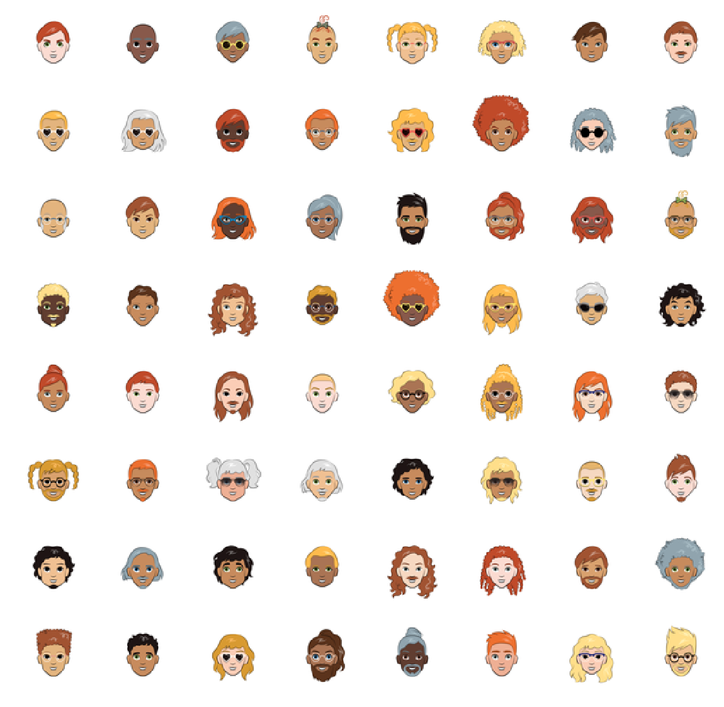
資料集
CARTOON
10000張500x500的RGB圖片

Slide 3
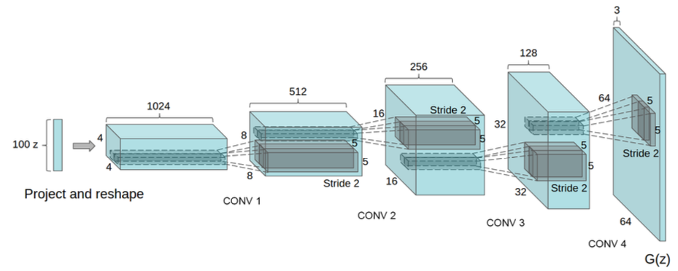
模型結構
Generator

Slide 4
模型結構
Generator
Input 雜訊
Output 生成圖片
Hidden layer 用CNN/DNN組成
Activation ReLU/SeLU/LeakyReLU
Batch Normalization在層與層之間
Output Activation設定為Tanh

Slide 5
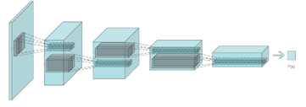
模型結構
Discriminator

Slide 6
模型結構
Discriminator
Input 圖片
Output 真實/生成
Hidden layer 用CNN/DNN組成
Activation ReLU/SeLU/LeakyReLU
Output Activation用Sigmoid

Slide 7
建構網路
用Keras建立網路

Slide 8
匯入套件
import numpy as np
import matplotlib.pyplot as plt
from glob import glob
import random
from PIL import Image
from keras.models import Model
from keras.optimizers import Adam
from keras.layers import Conv2D, UpSampling2D, Dense, Flatten, Input, BatchNormalization, Reshape, LeakyReLU

Slide 9
讀取資料
class DataLoader:
def __init__(self, folder_path, img_size):
self.folder_path = folder_path
self.img_size = img_size
self.path_list = glob(folder_path) # 讀取資料夾全部圖片路徑
def __imread(self, img_path):
'''讀取圖片'''
return np.array(Image.open(img_path).convert('RGB').resize(self.img_size[:-1]))

Slide 10
讀取資料
...
def sampling_data(self, batch_size, shuffle=True):
img_path_list = self.path_list
if shuffle:
random.shuffle(img_path_list)

Slide 11
讀取資料
...
for batch_idx in range(0, len(img_path_list), batch_size):
path_set = img_path_list[batch_idx : batch_idx + batch_size]
img_set = np.zeros((len(path_set),) + self.img_size)
for img_idx, path in enumerate(path_set):
img_set[img_idx] = self.__imread(path)
img_set = img_set / 127.5 – 1
yield img_set

Slide 12
建立Class
class GAN:
def __init__(self, noise_dim, img_size=(64, 64, 3))
self.noise_dim = noise_dim
self.img_size = img_size
self.dataloader = DataLoader('./cartoon/*.png', self.img_size)
# noise_dim = 雜訊維度
# img_size = 圖片大小

Slide 13
建立Generator
...
def build_generator(self):
noise_input = Input(shape=(self.noise_dim,))
# TODO: Build generator
return Model(noise_input, img)

Slide 14
建立Discriminator
...
def build_discriminator(self):
img_input = Input(shape=self.img_size)
# TODO: Build generator
return Model(img_input, validity)

Slide 15
連接網路
...
def connect(self):
self.generator = self.build_generator(self)
print(self.generator.count_params())
self.discriminator = self.build_discriminator(self)
print(self.discriminator.count_params())
self.optimizer = Adam(.0002, .5)
# Optimizer用Adam, Learning rate=0.0001~0.0002, 切勿調高
...

Slide 16
連接網路
self.discriminator.compile(optimizer=self.optimizer,
loss='binary_crossentropy',
metrics=['acc'])

Slide 17
連接網路
...
# 連接G和D
noise = Input(shape=(self.noise_dim,))
img = self.generator(noise)
self.discriminator.trainable = False # 在訓練G時, 鎖定D
validity = self.discriminator(img)
self.combined = Model(noise, validity)
self.combined.compile(optimizer=self.optimizer,
loss='binary_crossentropy')

Slide 18
訓練網路
...
def train(self, epochs, batch_size, sample_interval=200):
self.history = []
valid = np.ones((batch_size, 1)) # 1 = 真實圖片
fake = np.zeros((batch_size, 1)) # 0 = 生成圖片

Slide 19
訓練網路
...
for e in range(epochs):
for i, real_img in enumerate(self.dataloader.sampling_data(batch_size)):
# Train D
noise = np.random.standard_normal((batch_size, self.noise_dim))
fake_img = self.generator.predict(noise)
d_loss_real, real_acc = self.discriminator.train_on_batch(real_img, valid[:len(real_img)]
d_loss_fake, fake_acc = self.discriminator.train_on_batch(fake_img, fake)
d_loss = .5 * (d_loss_real + d_loss_fake)
d_acc = .5 * (real_acc + fake_acc)

Slide 20
訓練網路
...
# Train G
noise = np.random.standard_normal((batch_size, self.noise_dim))
g_loss = self.combined.train_on_batch(noise, valid)

Slide 21
訓練網路
...
if i % sample_interval == 0:
info = {
'epoch': e,
'iter': i,
'd_loss': d_loss,
'd_acc': d_acc*100,
'g_loss': g_loss
}
self.history.append(list(info.values()))
print('[Epoch %(epoch)d][Iteration %(iter)d]
[D loss: %(d_loss).6f, acc: %(d_acc).2f%%]
[G loss: %(g_loss).6f]' % info)
self.__sample_image(e)
return self.history

Slide 22
抽樣圖片及評估模型
def __sample_image(self, epoch):
r, c = 8, 8 # 列, 欄
noise = np.random.standard_normal((r*c, self.noise_dim))
img = self.generator.predict(noise).reshape((r, c) + self.img_size)
img = img * .5 + .5
fig = plt.figure(figsize=(20, 20))
axs = fig.subplots(r, c)
for i in range(r):
for j in range(c):
axs[i, j].imshow(img[i, j])
axs[i, j].axis('off')
fig.savefig('../Image/%05d.png' % epoch)
plt.close()

Slide 23
GAN
gan = GAN(128, img_size=(64, 64, 3))
gan.connect()
gan.train(200, 64, sample_interval=10)

Slide 24
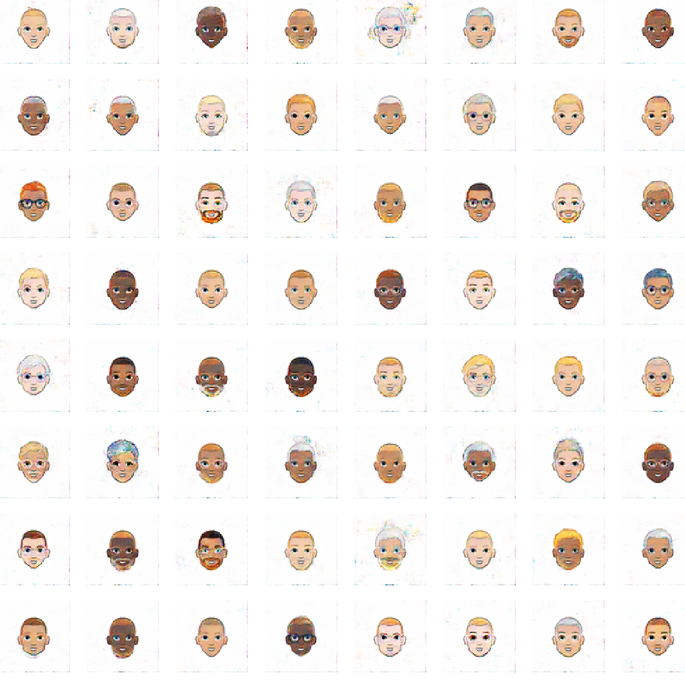
結果
Epoch 100

